Slide 1
TeamOne
Members
- Jay Turakhia
- Shlok Gandhi
- Chirayu Desai

Slide 2
WHY? WHAT? HOW?

Slide 3
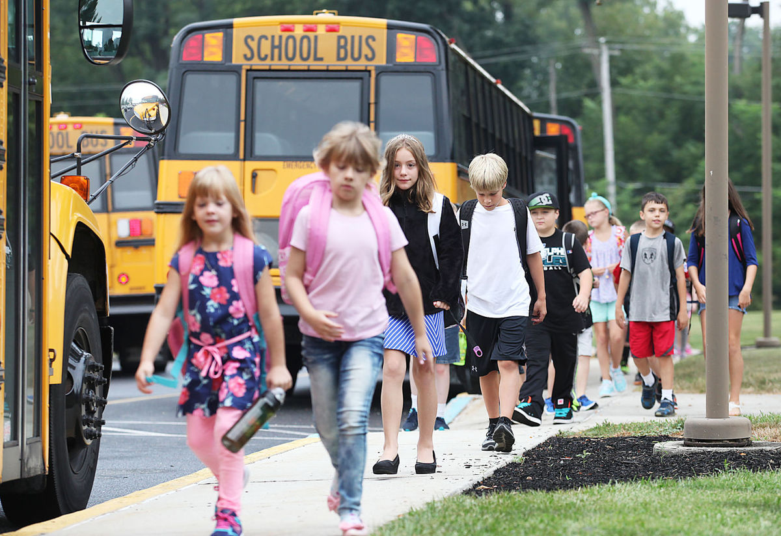
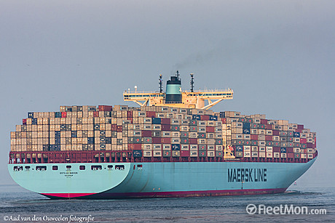
WHY ?

Slide 4
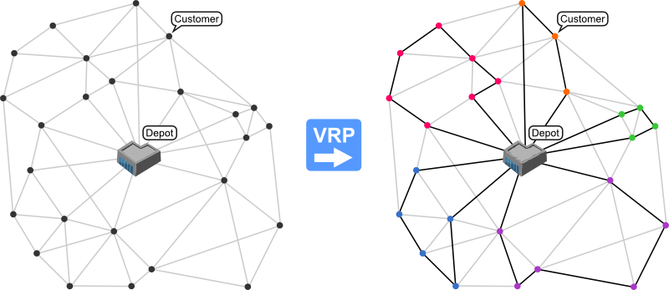
WHAT ?
Vehicle Routing Problem
Combinatorial optimization and integer programming problem seeking to service a number of customers with a fleet of vehicles.
Proposed by Dantzig and Ramser in 1959,
Variables ( several depots, dispersed cities /customers, vehicle fleet / delivery executives)
The objective - To deliver a set of customers with known demands on minimum-cost vehicle routes originating and terminating at a depot/s. ( with necessary restrictions or relaxations like…)
Application in the fields of transportation, distribution, and logistics.

Slide 5
HOW ?
Approach –
Evaluation -

Slide 6
Team Roles
Jay Turakhia
Shlok Gandhi
Chirayu Desai

Slide 7
References
http://www.orcomplete.com/computer/sertalpbilal/solving-vehicle-routing-problem
http://neo.lcc.uma.es/vrp/vehicle-routing-problem/

